Slide 1
Visualization & EDA
Session Plan

Slide 2
Learning Objectives of the session
To get an understanding of Statistics and the Data Visualization using Python

Slide 3
Structure of the Session:
Duration | Topic | Details
5 Min | Explanation of session structure | Explanation of the agenda and learning objectives of the session
25 min | Concepts covered in the videos of the week | Use the Pop Quiz to gauge the level of understanding of the learners on videos covered during the week and identify areas to focus on. Explanation of the concepts of Data Visualization where the group needs help.
50 min | Hands-on Case Study - Honey Production | A hands-on session to demonstrate topics covered in the week Work on the Honey Production Dataset. Visualise the data and perform Exploratory Data Analysis (EDA) to derive insights from the data. Summarise the key learnings from the case study.
20 min | Clarification of the doubts in Practice Exercises | Clarification of the doubts that learners may have in the Practice Exercises of the week
15 min | Buffer Zone for Question and Answers / Viz Careers (if there is interest) | Use this time to clarify additional doubts. Examples from the industry based on the mentor's past experience
5 min | Summary of the session | Summary of the week with the key takeaways Brief about the next session on Exploratory Data Analysis (Deep Dive)

Slide 4

Timeline
Students should be here
Week 1
Introduction to Python
Week 2
Numpy & Pandas
Week 3
Visualization & EDA
Week 4
EDA deep Dive
Week 5
Capstone Project
Mentor Session
here

Slide 5
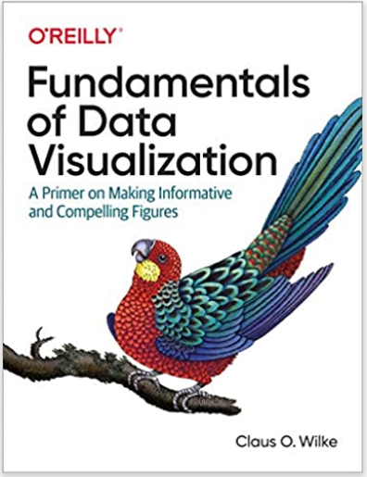
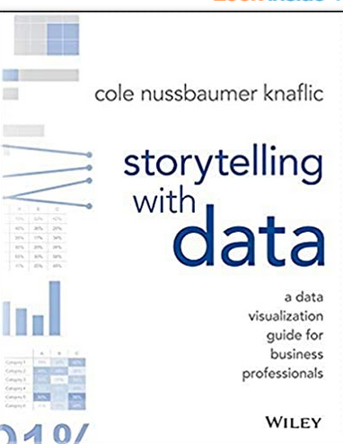
Brief intro about visualizations
Reference Link: https://matplotlib.org/
Reference link: https://seaborn.pydata.org/
Cheat Sheet: https://github.com/matplotlib/cheatsheets
Book Reference:
Fundamentals of Data Visualization– Claus O. Wilke
Storytelling with Data – Cole N. Knaffic

Slide 6
Visualization Breakdown
Visualization
Science
Stats
Python libs
Art
Palette
Attention
Good visualizations >> Great Visualizations

Slide 7
Good visualization > Great visualization (1/4)
Table |  |  |  |  | Heatmap
 |  |  |  |  | LOW-HIGH
 | A | B | C |  |  | A | B | C
Category 1 | 15% | 22% | 42% |  | Category 1 | 15% | 22% | 42%
Category 2 | 40% | 36% | 20% |  | Category 2 | 40% | 36% | 20%
Category 3 | 35% | 17% | 34% |  | Category 3 | 35% | 17% | 34%
Category 4 | 30% | 29% | 26% |  | Category 4 | 30% | 29% | 26%
Category 5 | 55% | 30% | 58% |  | Category 5 | 55% | 30% | 58%
Category 6 | 11% | 25% | 49% |  | Category 6 | 11% | 25% | 49%

Slide 8
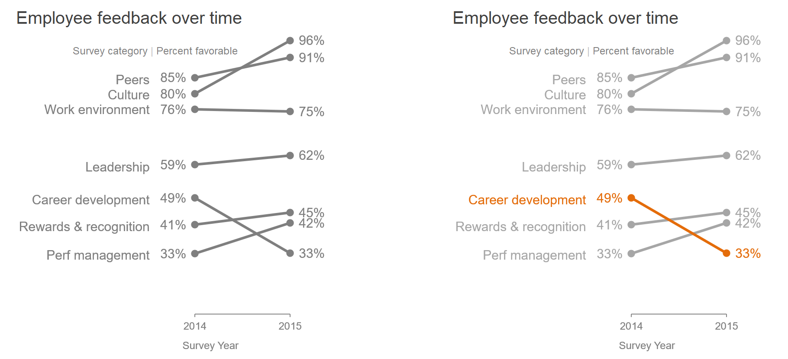
Good visualization > Great visualization (2/4)

Slide 9
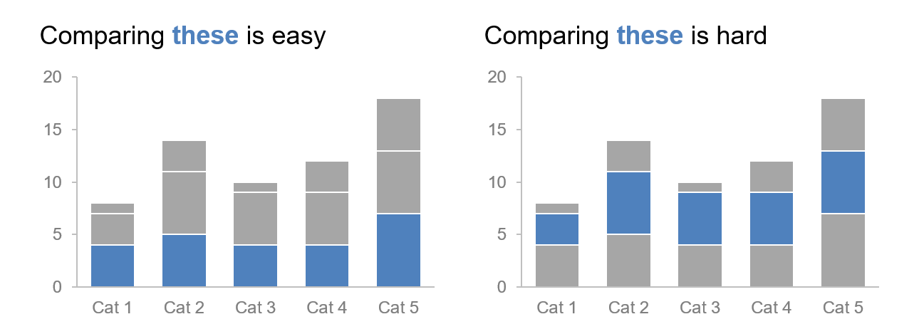
Good visualization > Great visualization (3/4)

Slide 10
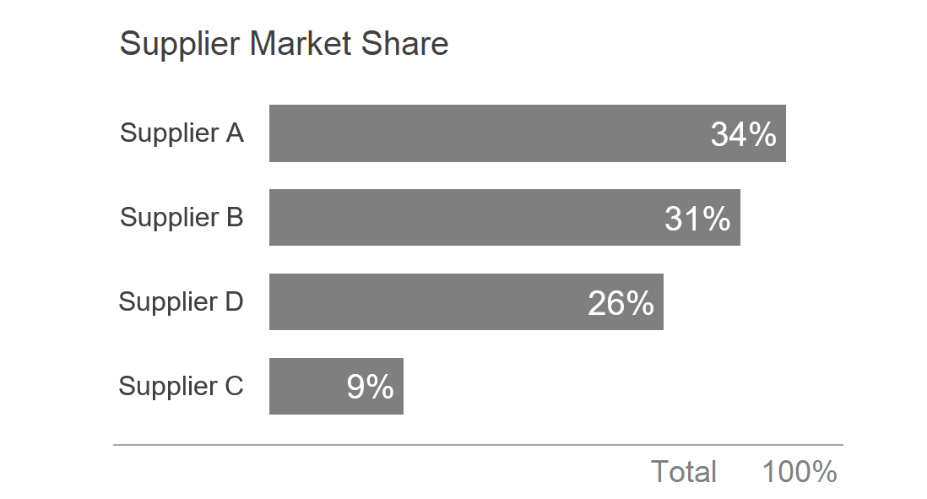
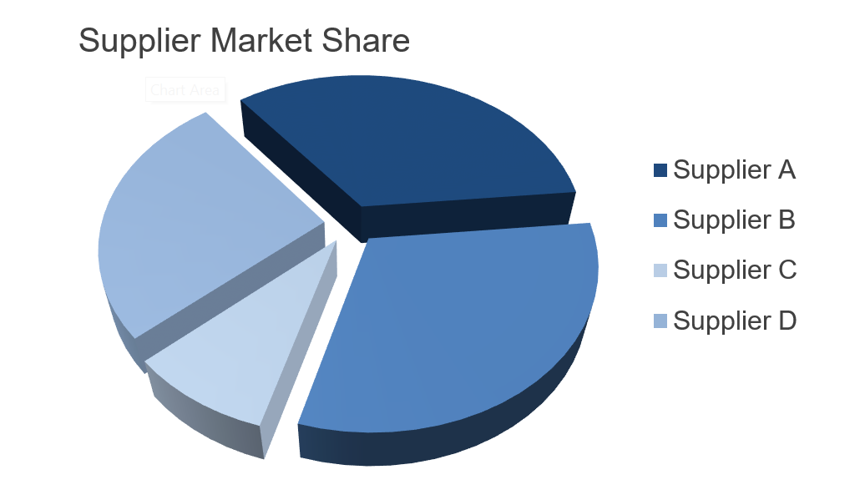
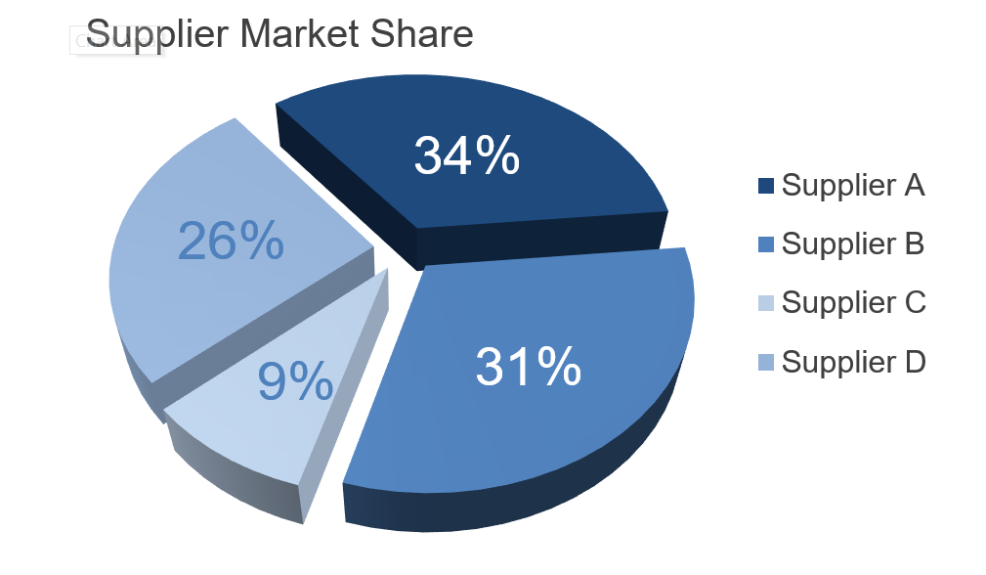
Poor > Good > Great visualization (4/4)

Slide 11
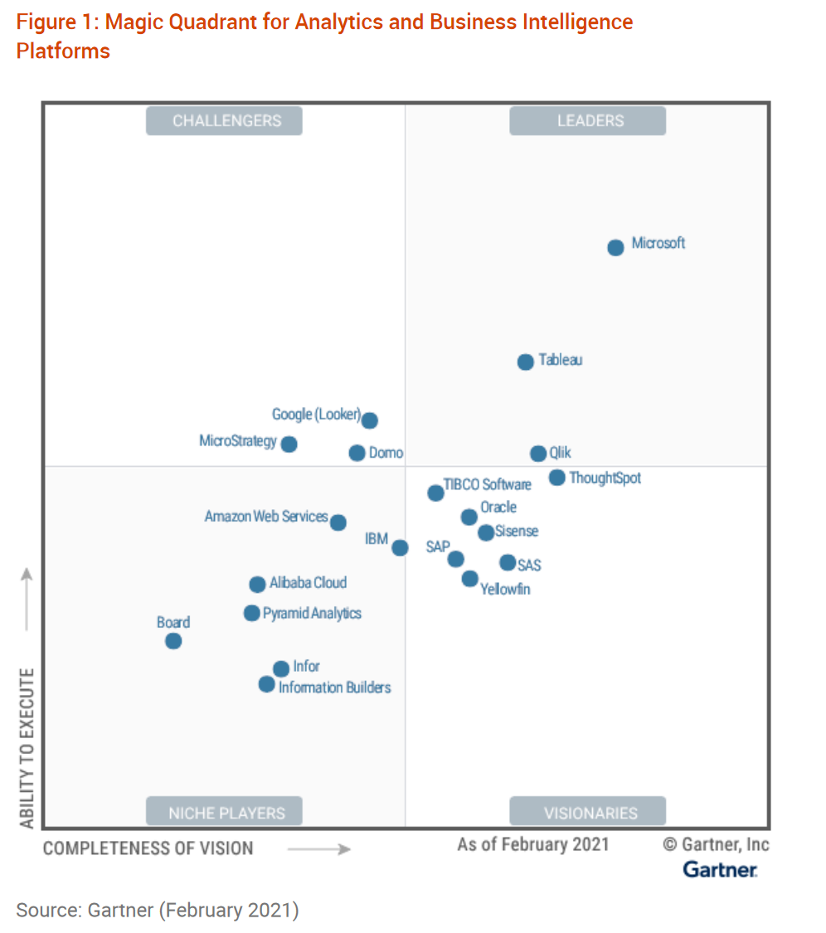
Visualization as a Career
Where is visualization used:
As a desktop-based exploratory tool → Data Science/ML
As an enterprise dashboarding tool → Business Analytics
BI Tools
Plotly/Dash apps
Discuss if time permits

Slide 12
Problem Statement - Honey Production Case Study
Background: In 2006, global concern was raised over the rapid decline in the honeybee population, an integral component of American honey agriculture. Large numbers of hives were lost to Colony Collapse Disorder, a phenomenon of disappearing worker bees causing the remaining hive colony to collapse. Speculation to the cause of this disorder points to hive diseases and pesticides harming the pollinators, though no overall consensus has been reached. The U.S. used to locally produce over half the honey it consumes per year. Now, honey mostly comes from overseas, with 350 of the 400 million pounds of honey consumed every year originating from imports. This dataset provides insight into honey production supply and demand in America from 1998 to 2016.
Objective: To visualize how honey production has changed over the years (1998-2016) in the United States.
https://www.kaggle.com/jessicali9530/honey-production

Slide 13
Key Questions & Steps
How has honey production yield changed from 1998 to 2016?
Over time, what are the major production trends been across the states?
Are there any patterns that can be observed between total honey production and value of production every year? How has value of production, which in some sense could be tied to demand, changed every year?

Slide 14
Dataset
state: Various states of U.S.
numcol: Number of honey-producing colonies. Honey producing colonies are the maximum number of colonies from which honey was taken during the year. It is possible to take honey from colonies that did not survive the entire year
yieldpercol: Honey yield per colony. Unit is pounds
totalprod: Total production (numcol x yieldpercol). Unit is pounds
stocks: Refers to stocks held by producers. Unit is pounds
priceperlb: Refers to average price per pound based on expanded sales. The unit is dollars.
prodvalue: Value of production (totalprod x priceperlb). The unit is dollars.
year: Year of production

